Slide 1


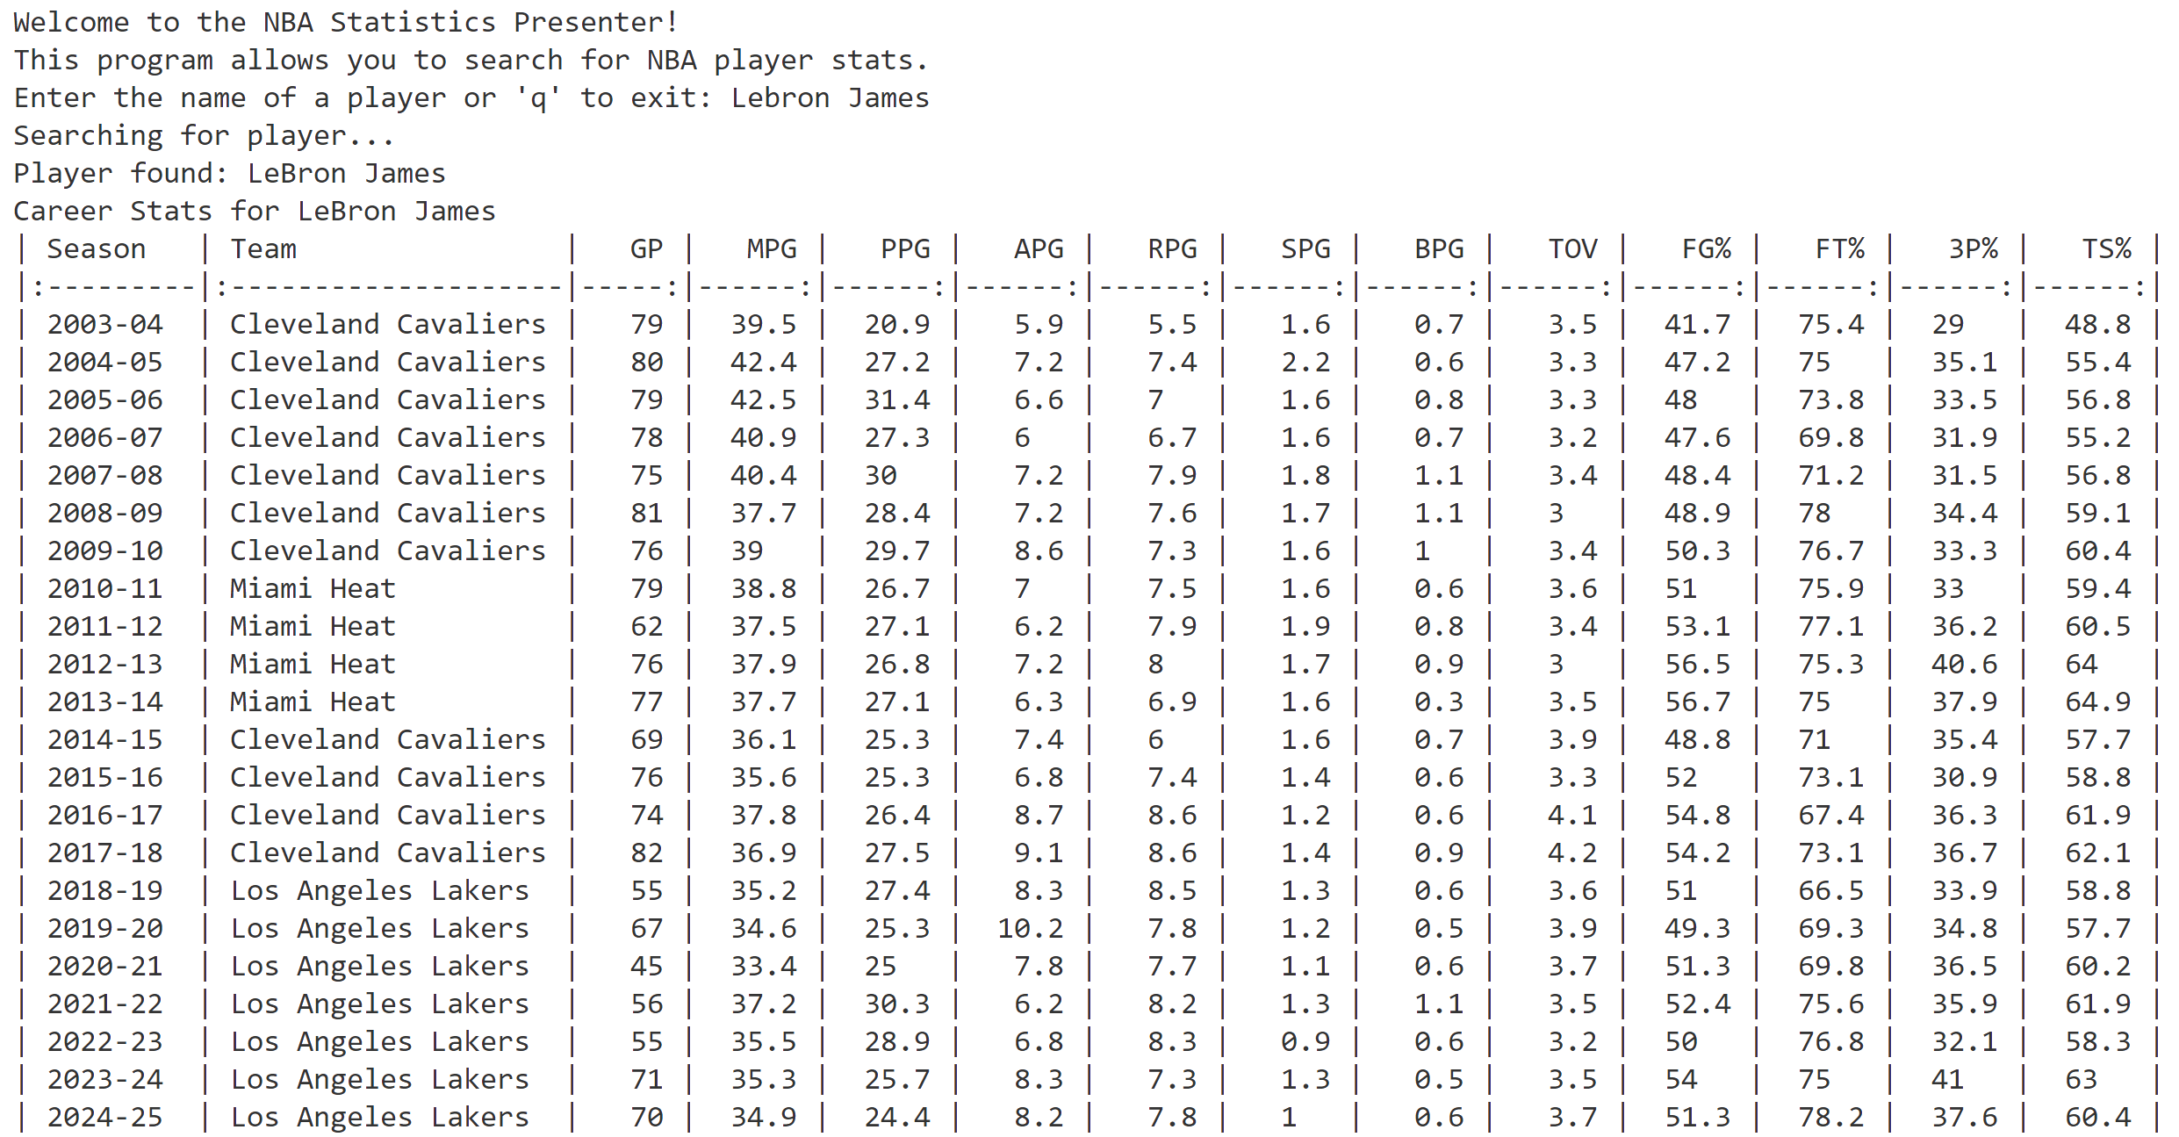
NBA STATISTICS PRESENTER
The NBA Statistics Presenter is designed to gather and present up-to-date statistics from the NBA. The casual fans, down to the most diehard NBA fans, can use this program to learn more about basketball or their favorite players.
This program uses an API to display the statistics of a player based on user input. When the user enters a player’s name, the program locates that player within the associated endpoints and returns that statistics for each season the player has played.
By : Jovon James
GitHub Repo: https://github.com/ksu-is/NBA_Stats

